Slide 1


21 DAYS OF
MACHINE LEARNING
11/21
---Code Warriors---

Slide 2

Why Logistic Regression ?
What'll do when the dependent variable(target) is categorical.
For example,
To predict whether an email is spam (1) or (0)
Whether the tumor is malignant (1) or not (0)
Consider a scenario where we need to classify whether an email is spam or not. If we use linear regression for this problem, there is a need for setting up a threshold based on which classification can be done.
But lets say if the actual class is spam, but model predicted a continuous value 0.4 and the threshold value is 0.5, the data point will be classified as not spam which can lead to serious consequence in real time. Thats why we need to come up with something better for classification.
---Code Warriors---

Slide 3
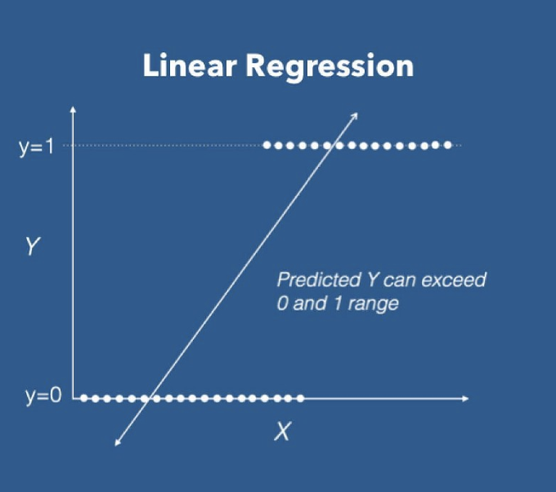
What is Logistic Regression ?
Logistic regression is another technique borrowed by machine learning from the field of statistics.and It uses probability for classification.
It can be used for binary or multi-class classification problems. In this video you will learn about the logistic regression algorithm for machine learning.
Logistic regression uses an equation as the representation, very much like linear regression.
eqn: y = mx + c
---Code Warriors---

Slide 4
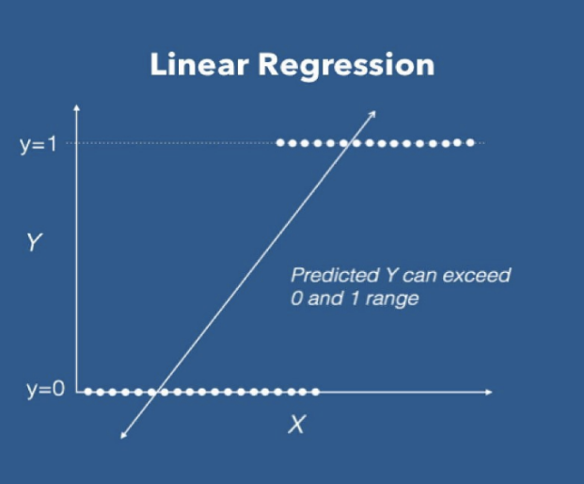
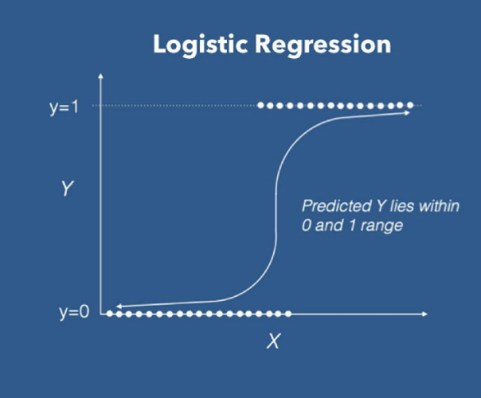
How it Works
eqn : y = mx + c
eqn : p = sigmoid(y)
sigmoid(y) = 1/(1+e^(-y))
---Code Warriors---

Slide 5
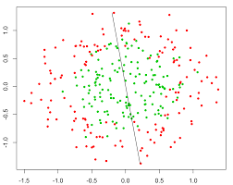
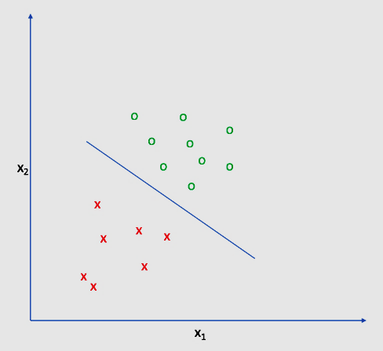
Logistic Regression
Advantages
Dis-Advantages
Logistic Regression is one of the simplest machine learning algorithms and is easy to implement and training a model with this algorithm doesn't require high computation power..
Logistic Regression proves to be very efficient when the dataset has features that are linearly separable.
Non linear problems can't be solved with logistic regression since it has a linear decision surface.
The presence of data values that deviate from the expected range in the dataset may lead to incorrect results as this algorithm is sensitive to outliers.
---Code Warriors---

Slide 6
Logistic Regression
1
from sklearn.linear_model import LogisticRegression
2
classifier = LogisticRegression()
3
classifier.fit(X_train,Y_train)
4
y_pred = classifier.predict(X_test)
---Code Warriors---

